Slide 1
Oil Dependency
By: Ryan, Joey, Casey, and Mack

Slide 3
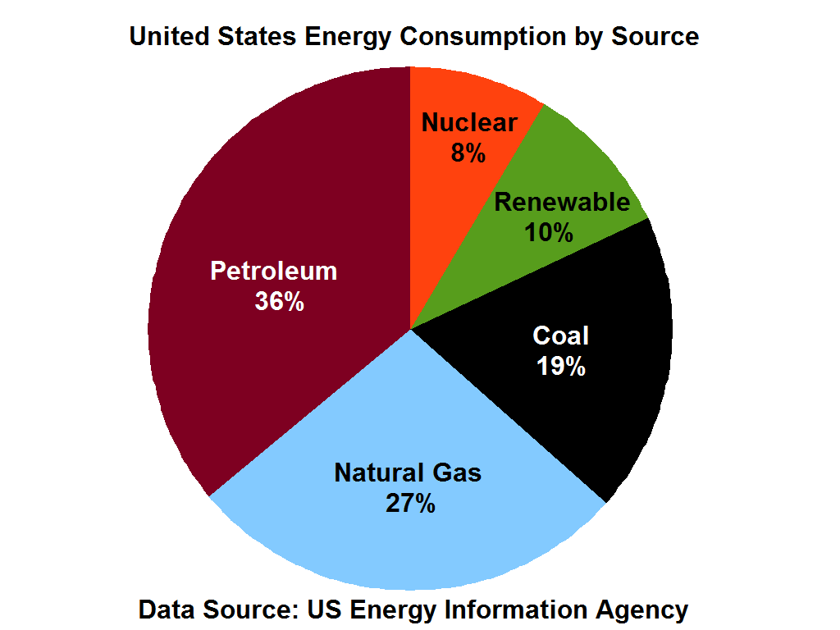
Energy Consumption
The United States is the largest energy consumer in the world
Renewable energy makes up only 10% of the energy consumed by the US
Methods used to extract oil and coal are harmful to the environment.
Notes:
Fracking has become common is the US. (describe fracking) Fracking uses 75 trillion gallons of fresh water and 360 billion gallons of over 600 chemical that end up polluting most of the nearby ground water. About 30 percent of California’s total annual water supply comes from groundwater in normal years, and up to 60 percent in drought years.
Video - https://www.youtube.com/watch?v=4LBjSXWQRV8

Slide 4
First bullet point here
Second bullet point here
Third bullet point here

Slide 5
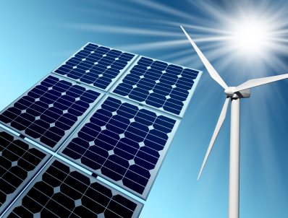
Solar, Wind, and Hydro Power
Solar is expensive and only works in direct sunlight
Wind turbines are tall, heavy, and expensive. They only work in areas with high amounts of wind
Hydro power makes up 6% of the 10% use of renewable energy in the US. Hydro power takes a lot of time and money to set up, but its very rewarding.

Slide 6
Introducing the HP-ICE
Hydrogen
Water
Oxygen
Heat
Input Hydrogen and Oxygen
Output of heat and pure water
50% efficient.
+
=

Slide 7
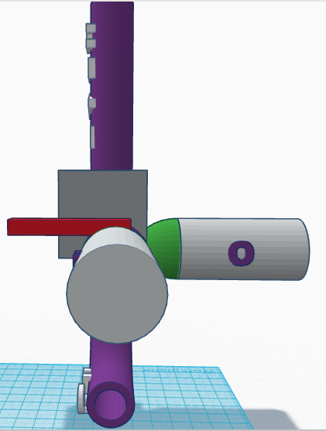
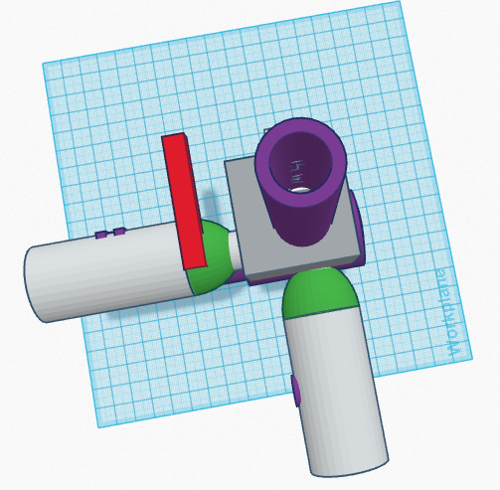
Prototype 1

Slide 8
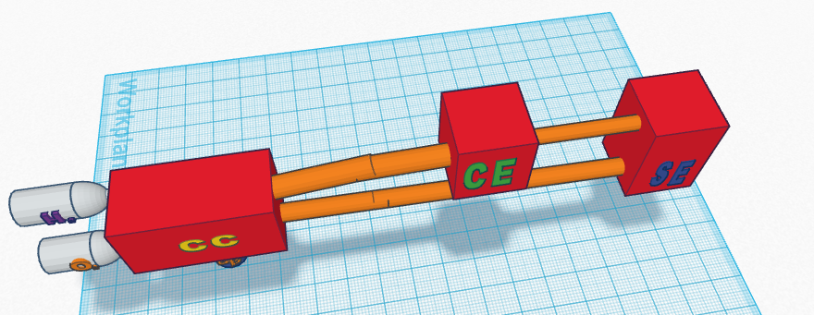
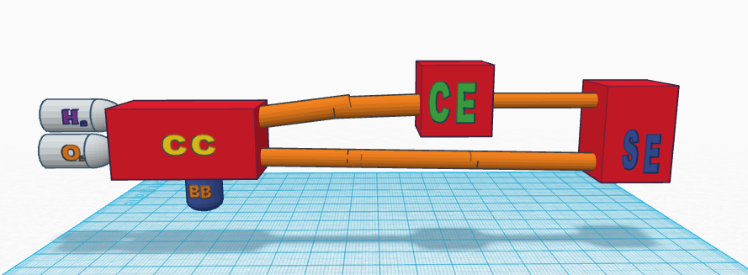
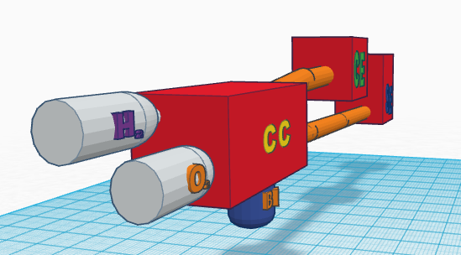
Prototype 2

Slide 9
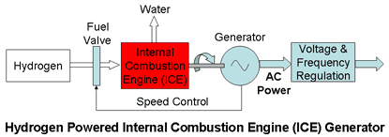
Combustion Chamber (CC)
Heat is added to Hydrogen and Oxygen
Causes explosion
Water byproduct
Explosion funneled to CE
Water funneled out

Slide 10
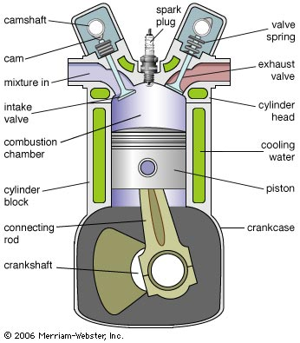
Combustion Engine (CE)
Explosion powers piston
Turns axle generating electricity
Exhaust channeled outward

Slide 11
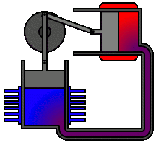
Sterling Engine (SE)
Separate cooling and heating sources
Compression and expansion of fluids
Causes turning of axle

